Slide 1



EDA ON RESTAURANT SALES DATA
By Arun Sundhar N

Slide 2

INTRODUCTION
Dataset from Kaggle: “Restaurant Sales – Dirty Data for Cleaning Training”
Contains intentionally messy sales data
Goal: Clean data, explore patterns, and extract business insights
01

Slide 3
DATASET OVERVIEW
Columns: Customer ID, Category, Item, Price, Quantity, Order Total, Order Date, Payment Method
Derived Features: Year, Month, Day, Weekday
Size: ~5000 records
02

Slide 4

DATA CLEANING
Dropped: Order ID
Filled Missing Values:
Item → Mode
Price & Quantity → Mean
Order Total → Price × Quantity
Payment Method → Mode
Converted numeric values into integers
03

Slide 5
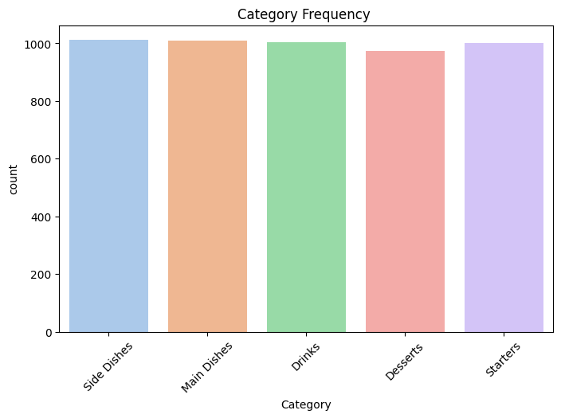
UNIVARIATE ANALYSIS
Frequency → Certain categories dominate (e.g., Main Dishes)
Payment Methods → Cash most frequently used
Monthly Sales → Seasonal spikes in some months
04

Slide 6

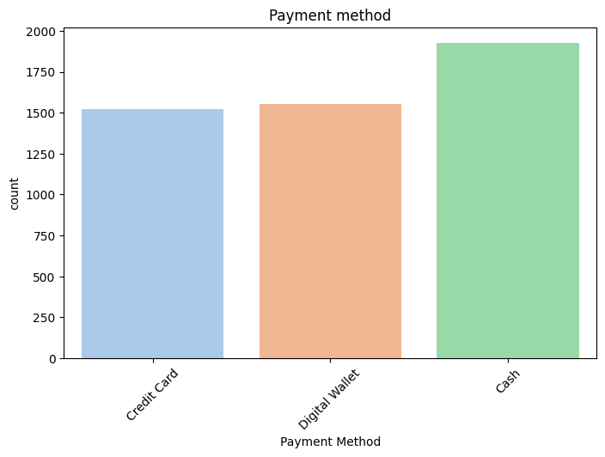
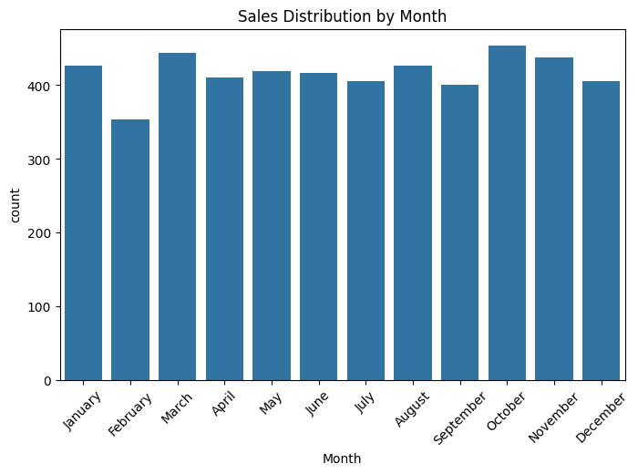
UNIVARIATE ANALYSIS
05

Slide 7
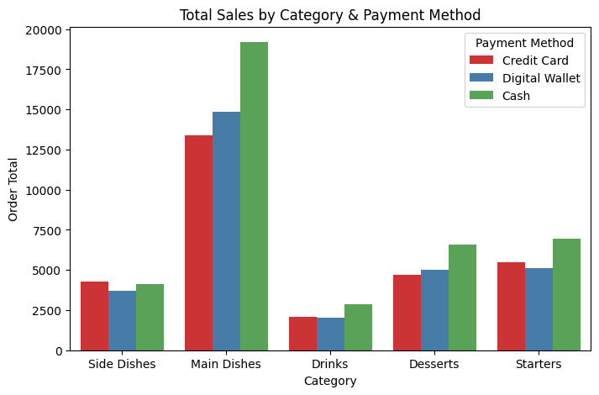
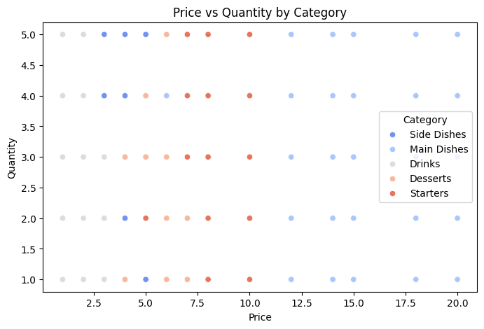
BIVARIATE ANALYSIS
Category vs Order Total (by Payment Method) → Main Dishes & Side Dishes drive higher revenue
Price vs Quantity → Clear demand differences across categories
06

Slide 8
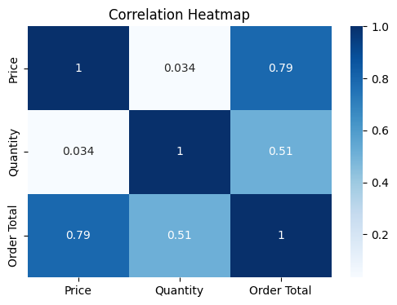
MULTIVARIATE ANALYSIS
Heatmap → Strong correlation between Price, Quantity & Order Total
07

Slide 9
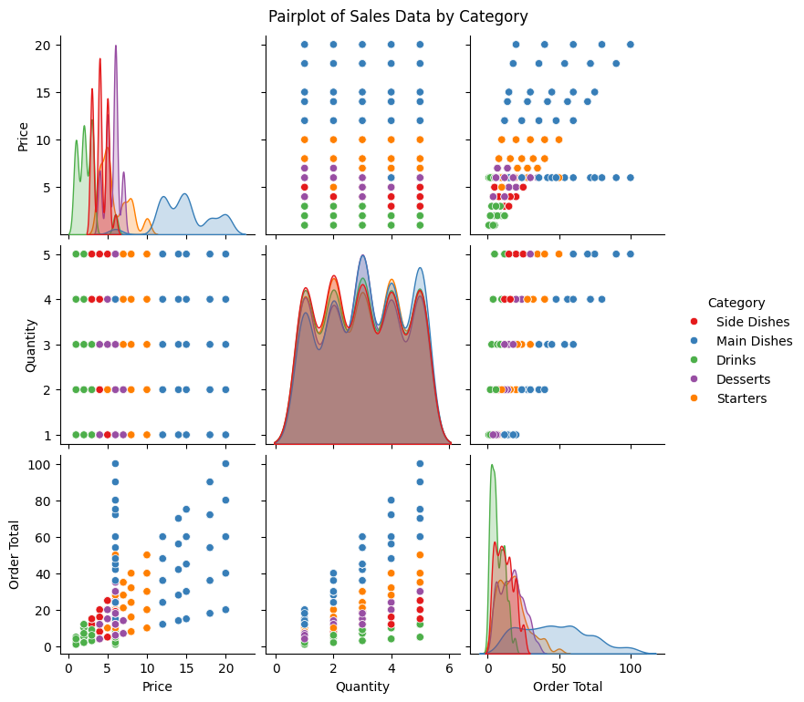
MULTIVARIATE ANALYSIS
Pairplot → Category-wise distribution patterns differ
08

Slide 10
STATISTICAL ANALYSIS
T-Test
Compared sales between top 2 categories
p-value < 0.05 → Significant difference
ANOVA
Compared across all categories
p-value ≈ 0 → At least one category has significantly different sales
09

Slide 11
INSIGHTS
Certain categories (like Main Dishes) consistently dominate sales
Cash is the most common payment method
Seasonal/monthly spikes show peak dining times
Sales differ significantly across categories (confirmed by stats)
09

Slide 12
CONCLUSION
Cleaned messy restaurant sales data successfully
Identified customer preferences in categories & payments
Found seasonal demand trends
Statistical validation strengthens findings
Insights can help in:
1.Menu optimization
2.Payment strategy planning
3.Seasonal promotion.
09

Slide 13
THANK YOU
10

